Slide 1

Computer Vision (CV)
Lab3
Convolutional Neural Network
(CNN)

Slide 2
Image
Computers Sees An Input Image As Array Of Pixels And It Depends On The Image Resolution.
It Will See
H * W * D
( H = Height, W = Width, D = Dimension ).

Slide 3
Convolutional neural network (CNN)
CNNs designed for working with two-dimensional image data, also they can
be used with one-dimensional and three-dimensional data.

Slide 4
Convolutional Layers
• Convolution is the first layer to extract features from an input image.
• Convolution keeps the relationship between pixels by learning image features using small squares of input data.
• It is a mathematical operation that takes two inputs such as image matrix and a filter or kernel.
Contains:
• Padding
• Stride
• Activation Function
(0*0) + (-1*0) + (0*0)
(-1*0) + (5*60) + (-1*113)
(0*0) + (-1*73) + (0*121)
= 114

Slide 5
Convolutional Layers
Stride
Padding

Slide 6
Convolutional Layers

Slide 7
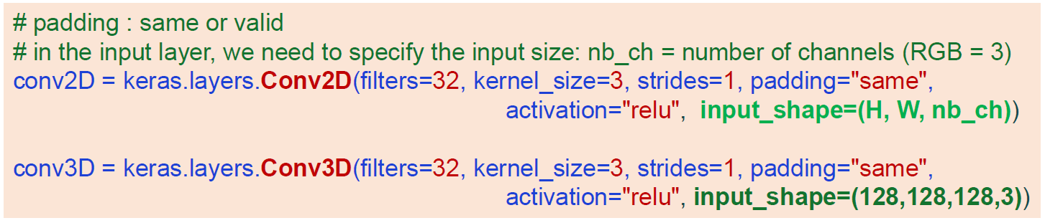
Convolutional Layers

Slide 8
Pooling Layer
Pooling is a down-sampling operation that reduces the dimensionality of the feature map.
Reduce the number of parameters when the images are too large which reduces the dimensionality of each map but retains important information.
types:
–Max Pooling
–Average Pooling

Slide 9
Pooling Layer

Slide 10
Flatten Layer

Slide 11
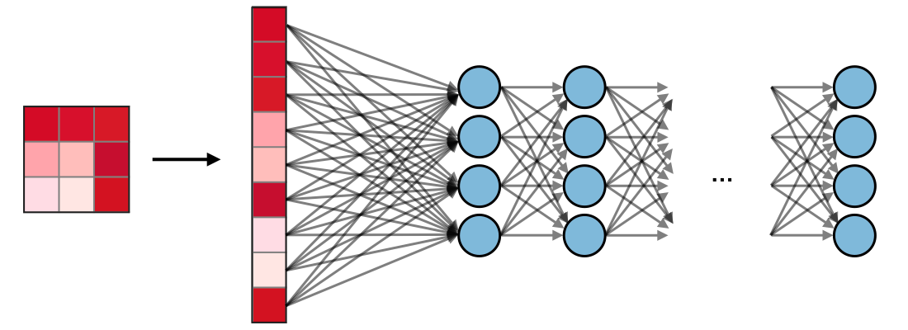
Fully Connected (FC)
The fully connected layer (FC) operates on a flattened input where each input is connected to all neurons. If present, FC layers are usually found towards the end of CNN architectures and can be used to optimize objectives such as class scores.

Slide 12
Batch Normalization
The BatchNormalization layer normalizes the activations by adjusting the mean and variance.

Slide 13
Dropout
Connections between consecutive layers are randomly dropped based on a dropout-ratio and the remaining network is trained in the current iteration.
Code :
model.add(tensorflow.keras.layers.Dropout(0.3))

Slide 14
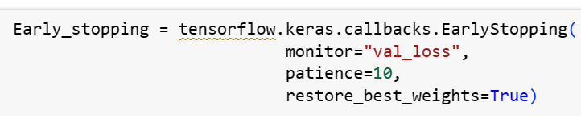
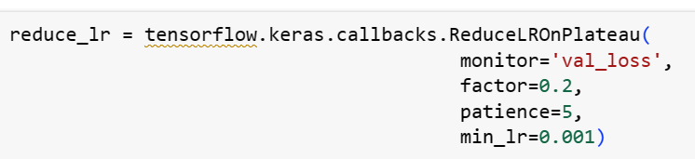
Callbacks
1. EarlyStopping
2. ReduceLROnPlateau

Slide 15
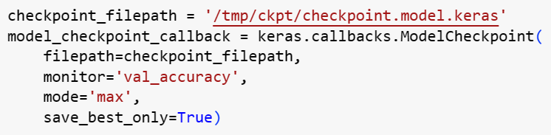
Callbacks
3. ModelCheckpoint
How add in Training Model

Slide 16
Image Augmentation
Image augmentation is an engineered solution to create a new set of images by applying standard image processing methods to existing images.
methods:
– Rotation
– Zoom
– Height and width shifting
– shear
– Lighting transformations
– Crop
– Noise addition
– Cutout or erasing

Slide 17
Deep learning
Advantages
Automatic learning of features
Able to solve complex tasks
Able to generalize
Disadvantages
Too dependent on the quality of training data
Requires large amounts of data to generalize
Models tend to be large in size
Requires a high computing power and memory/storage

Slide 18

Kaggle is the world's largest data science community with powerful tools and resources to help you achieve your data science goals

Slide 19
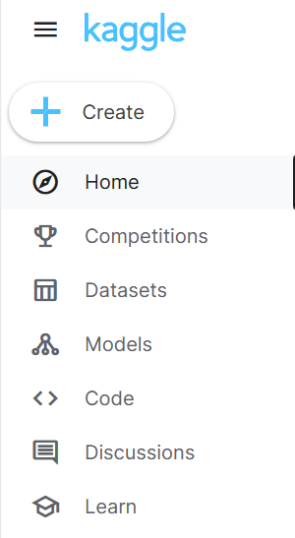
Search for datasets
Run your code online
Work with a team
Join competitions
Find lessons and tutorials
Find models built by others

Slide 20
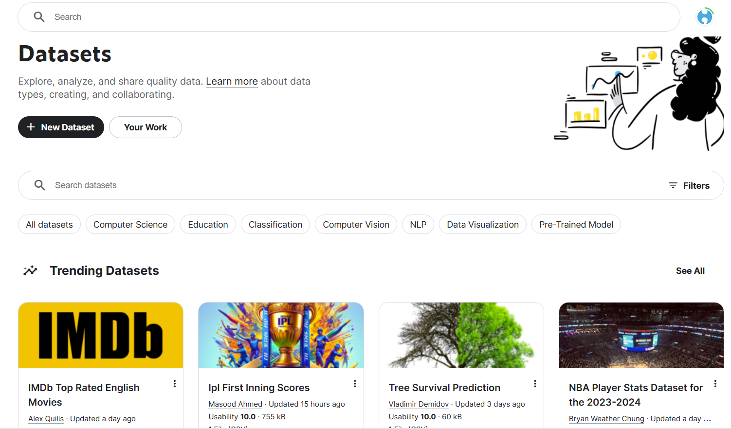
Search or upload a dataset

Slide 21
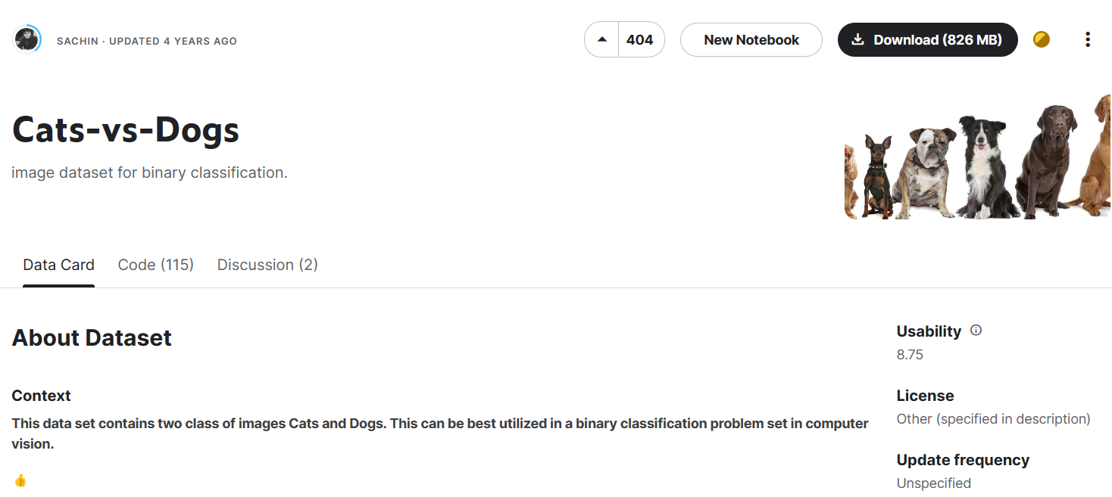
Find data description, code by others, and discussion
Download dataset or work online

Slide 22
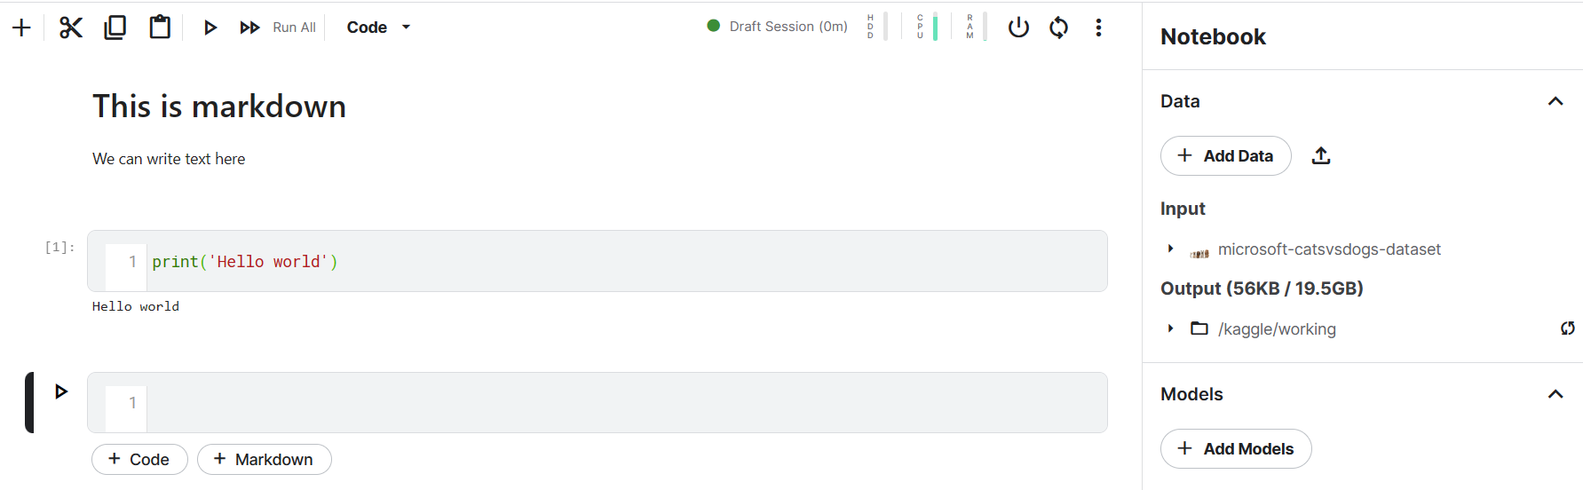
Work online in a jupyter-like environment

Slide 23
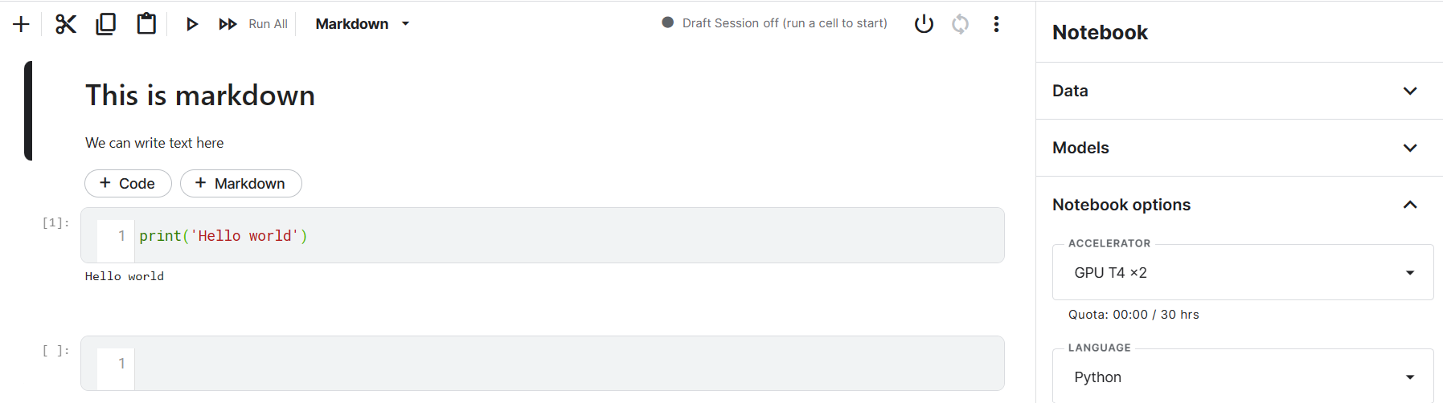
Use free accelerators like GPU or TPU

Slide 24

Join competitions and earn prizes

Slide 25

Find lessons and tutorials

Slide 26
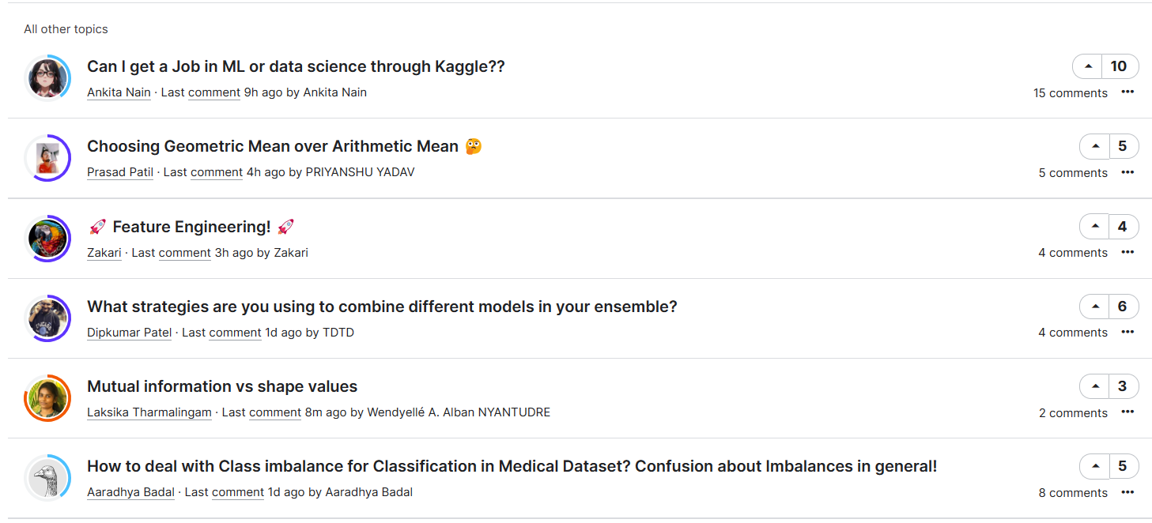
Find discussions, ask questions and interact with the community

Slide 27
Explore Kaggle
Read more on Kaggle: Your Home for Data Science

